Slide 1

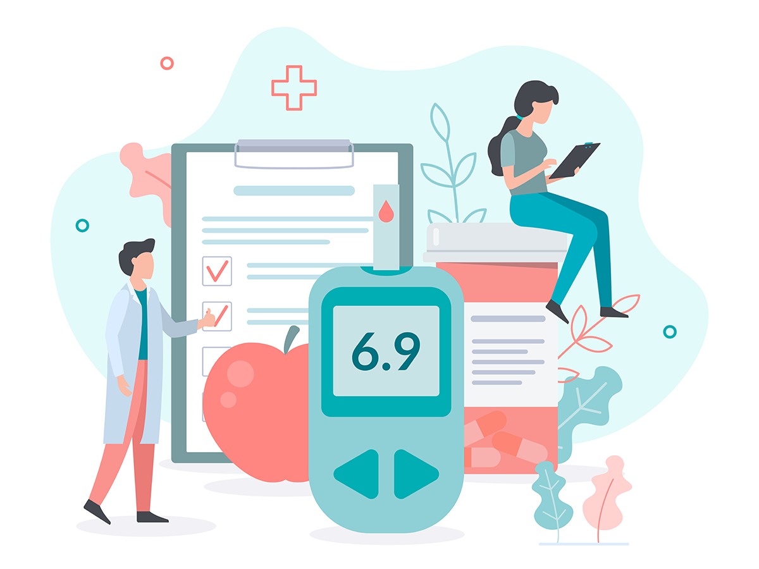
DiaBeta
Intelligent, Secured Smart App for Complete Diabetes Lifestyle Management
2022-256

Slide 2
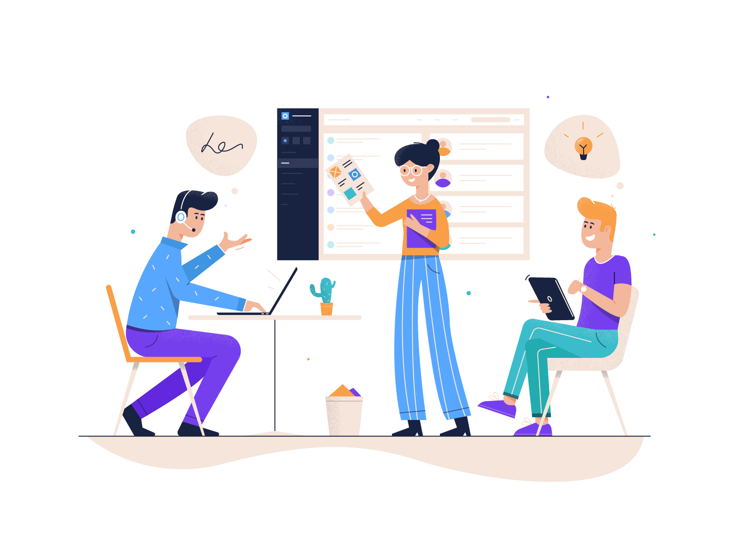
Team Members
Supervisor: Ms. Suriya Kumari
Co Supervisor: Mr. Ravi Supunya
Student Name | Student ID
Jayasekara J.T.N.N (Leader) | IT19115894
Gunasekera R.H. | IT19184272
Ravindu Hasanka V.G. | IT19156798
Hasintha Kashmika H.B.G. | IT19115962

Slide 3

ee
Introduction
Why Diabetes Management is important?
Diabetics are at a higher risk of developing ailments such as heart disease, renal disease, stroke, vision problems, nerve damage etc.
People with better diabetes control, may expect to live active, independent, and vigorous lives.
Diabetes management requires awareness.

Slide 4

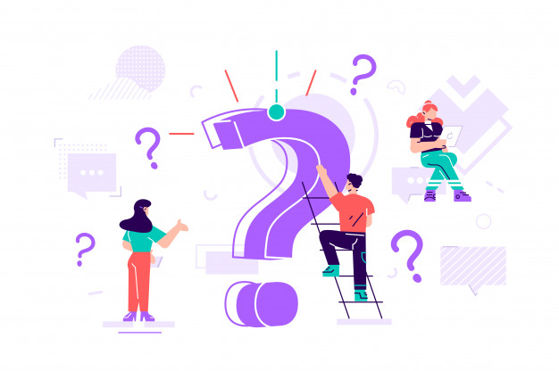
Research Problem
Diabetes is a lifelong illness.
There's no cure for type 2 diabetes.
So, prevention and control are essential.
Effective lifestyle management takes awareness, education, and consideration.

Slide 5
Research Objectives
01
02
Recommend Diets and Exercise Plans
Predict Diabetes
03
04
Identify Health Risk
Measure Glucose Level, Heart Rate and SpO2

Slide 6
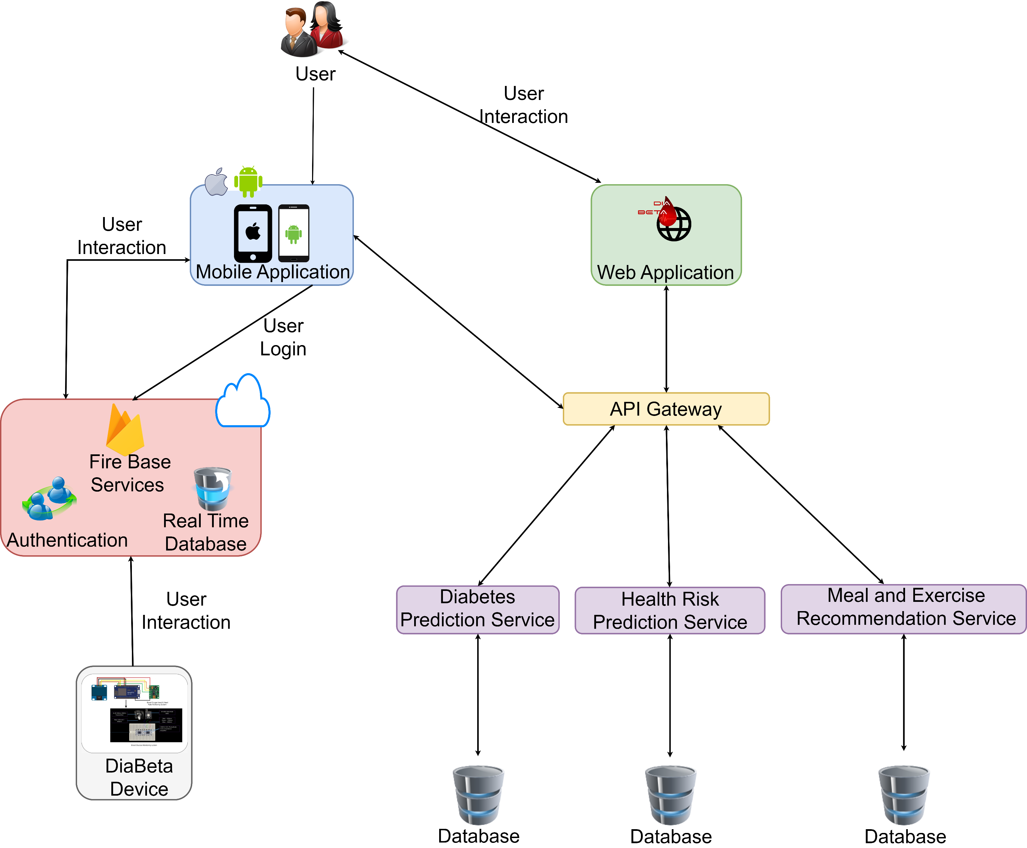
Overall Solution as a System Diagram

Slide 7

Diabetes Prediction
Jayasekara J.T.N.N.
IT19115894
Software Engineering

Slide 8
Research Questions
Diabetes is becoming more prevalent in people's daily lives.
Diabetes often have no symptoms at first.
Prediction of diabetes is important.
Diabetes patient having intelligent reminders about time to take medicine, clinic dates and other important facts is also helpful.

Slide 9

Specific and Sub Objectives
Predicts diabetes
Generates a questionnaire to gather necessary information from the user and analyse answers.
Provide ability to add, update, delete users' daily glucose, insulin, pills information and generate reports.
Give reminders and recommendations.

Slide 10
Methodology
01
03
System Diagram
Requirements
02
Technology
IT19115894 | Jayasekara J.T.N.N| Project ID : 2022-256

Slide 11
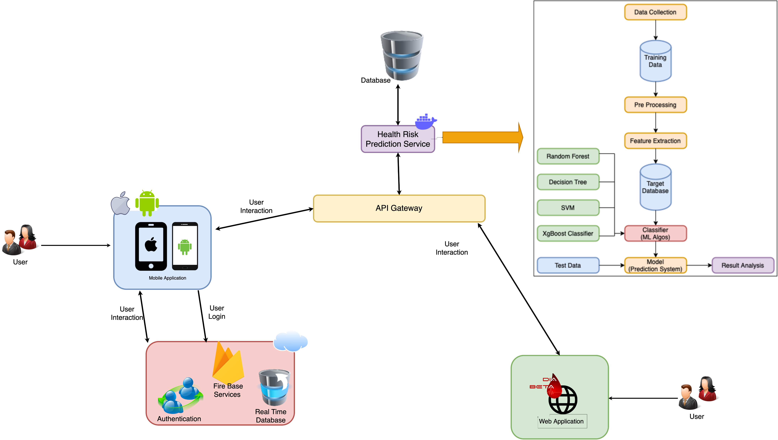
System Diagram
IT19115894 | Jayasekara J.T.N.N| Project ID : 2022-256

Slide 12





Tools and Technologies
Tools
V
Visual Studio Code
Postman
Jupyter Notebook
Flask
Fire Base
Technologies
V
Flutter
Dart
Python
PHP
IT19115894 | Jayasekara J.T.N.N| Project ID : 2022-256

Slide 13
Current Progress – IT19115894 (90%)
Generates a questionnaire to gather necessary
information from the user
Implement diabetes prediction model.
Deploy model using flask and create API.
Provide ability to add, update, delete users’
daily glucose, insulin, pills information.
Implement User Interfaces
90%
IT19115894 | Jayasekara J.T.N.N| Project ID : 2022-256

Slide 14

Screenshots of the current work
Project Evidence
IT19115894 | Jayasekara J.T.N.N| Project ID : 2022-256

Slide 15
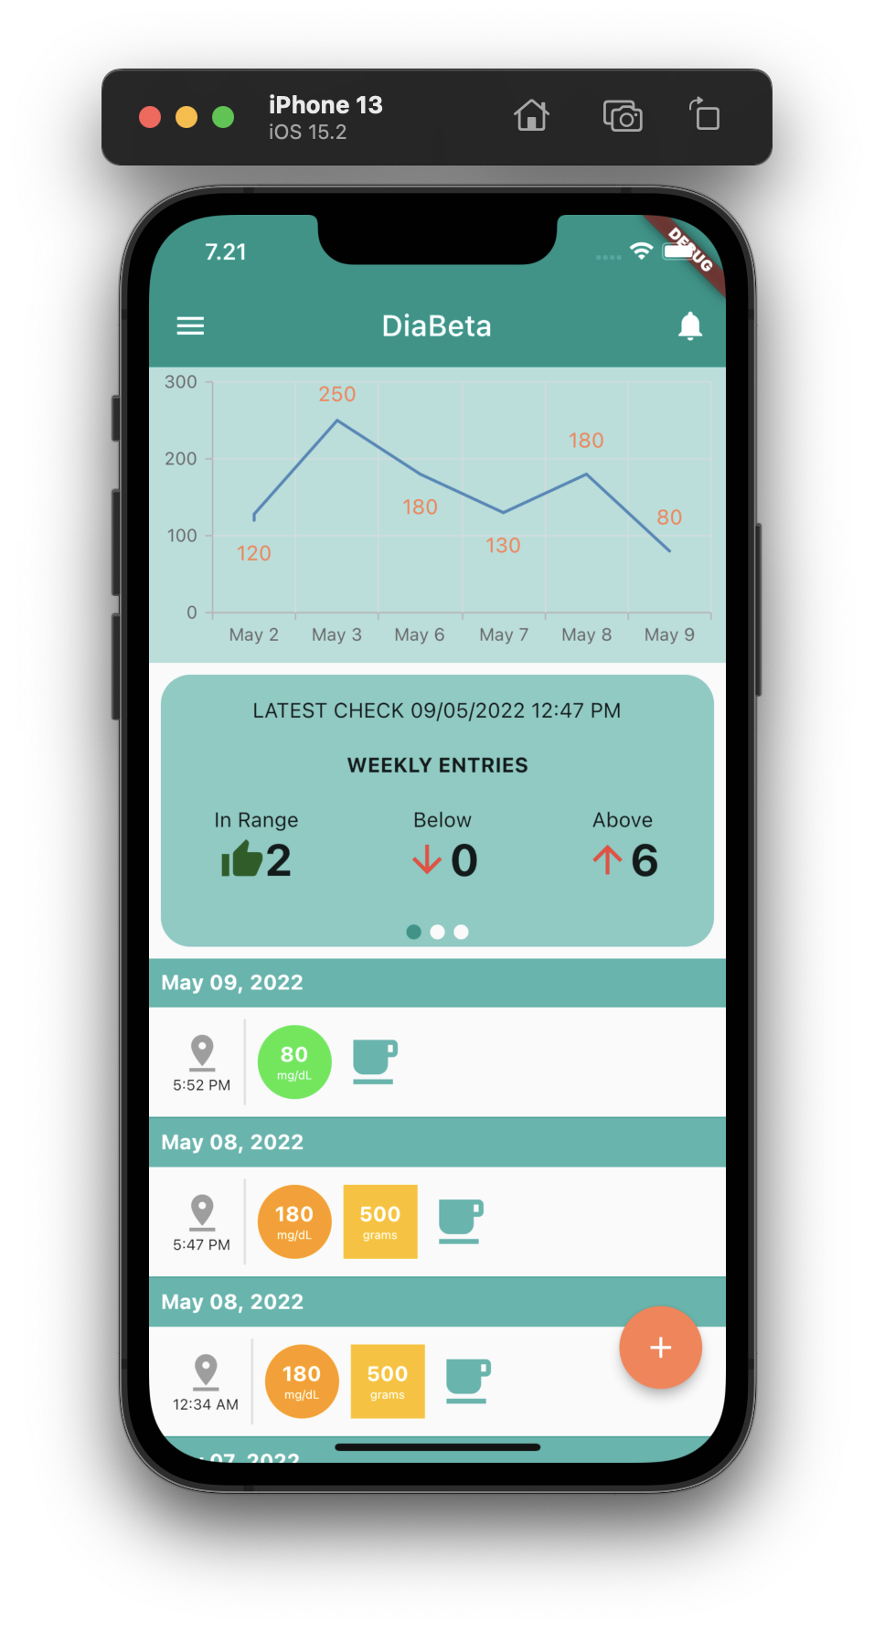
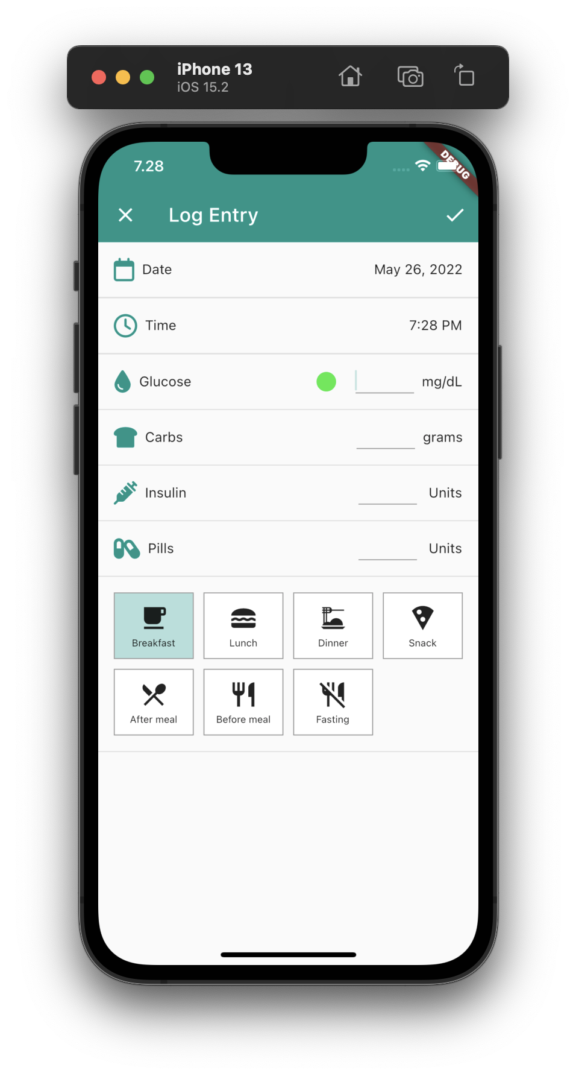
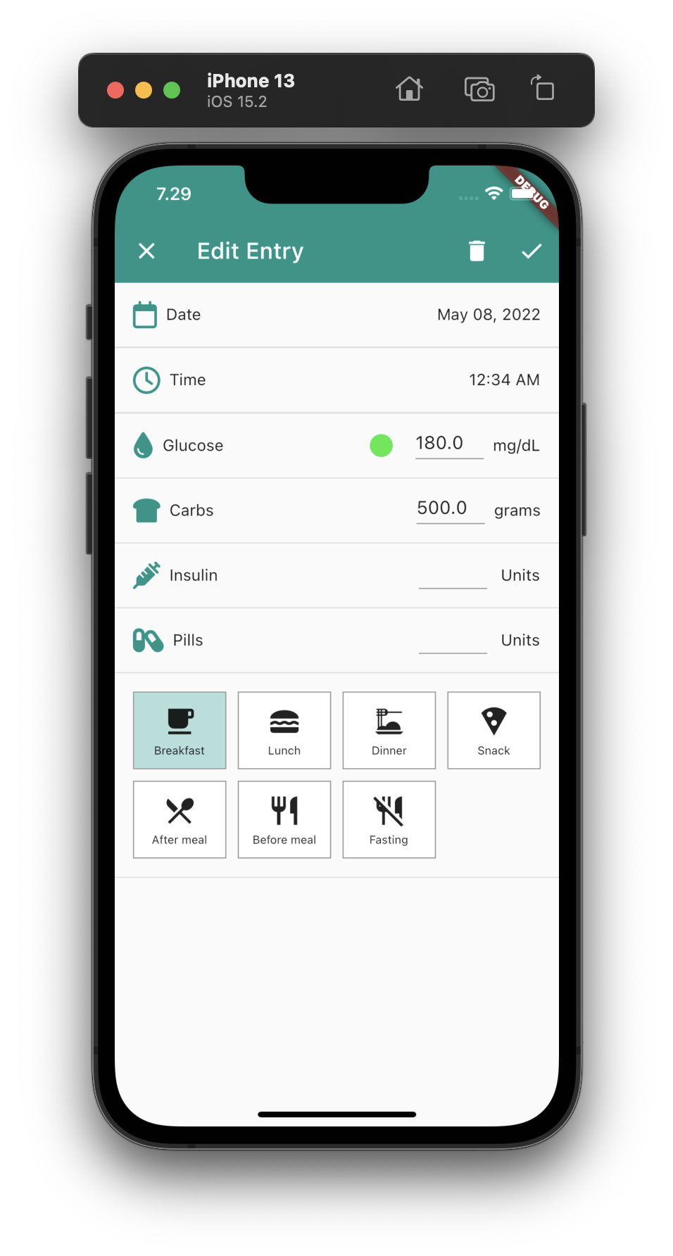
Project Evidence - IT19115894
Dashboard
Add Log Entry
Edit Log Entry

Slide 16
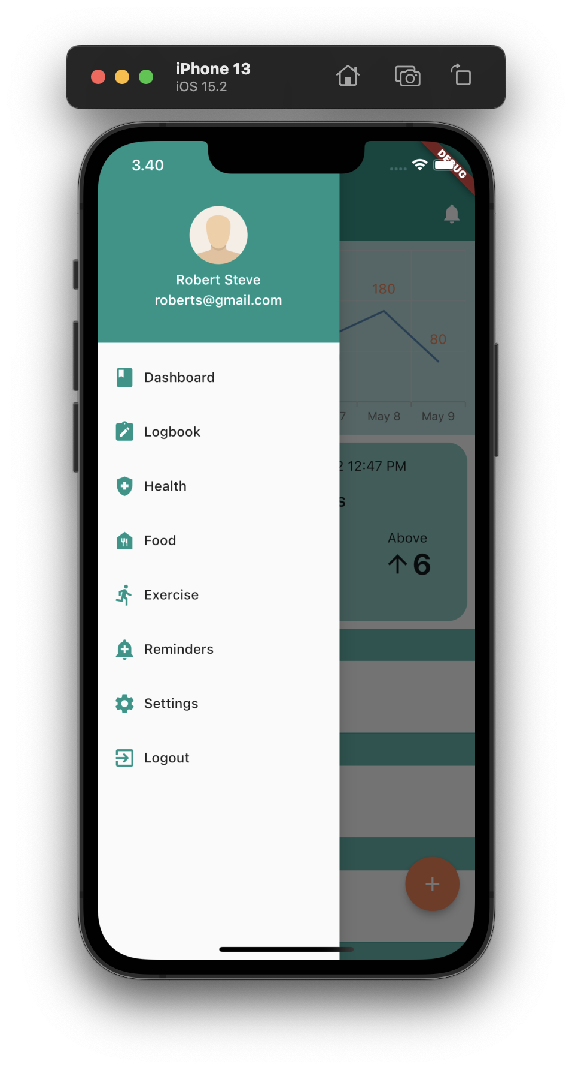
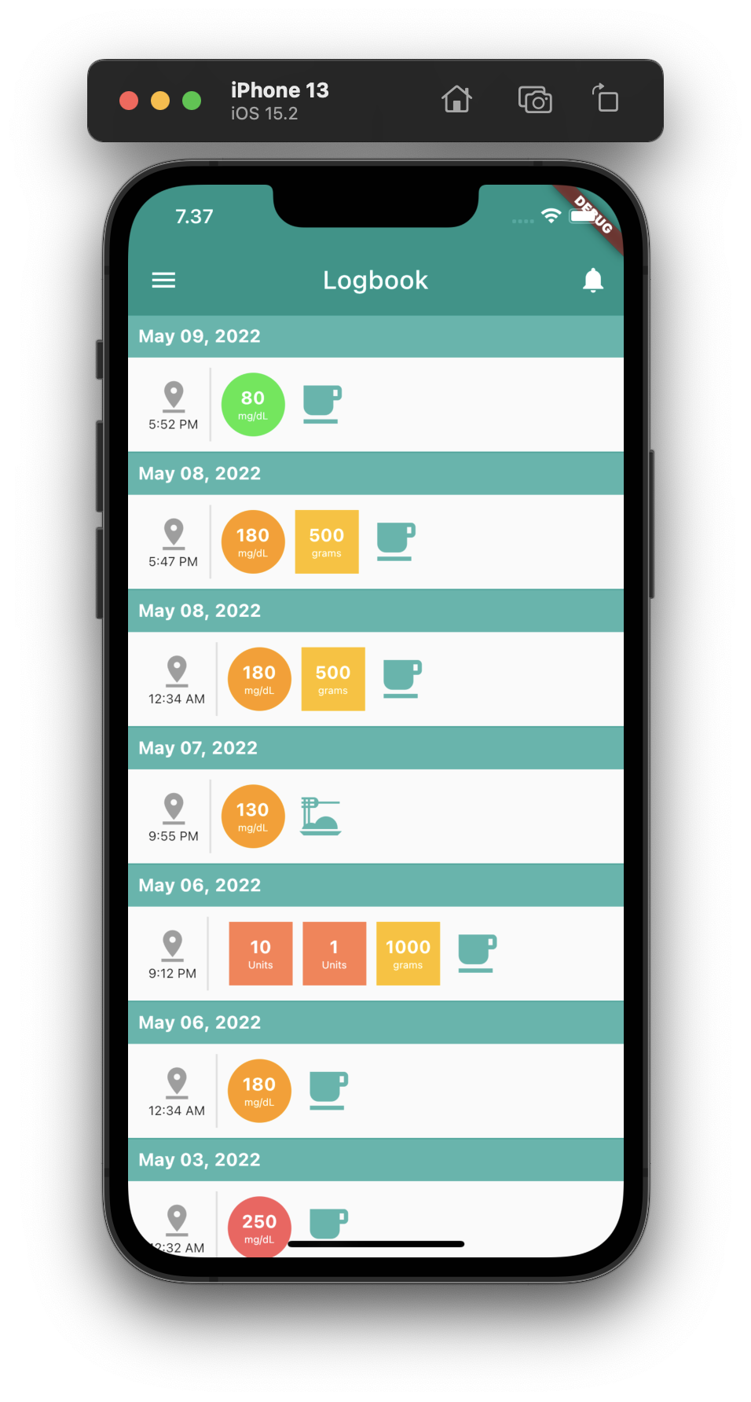
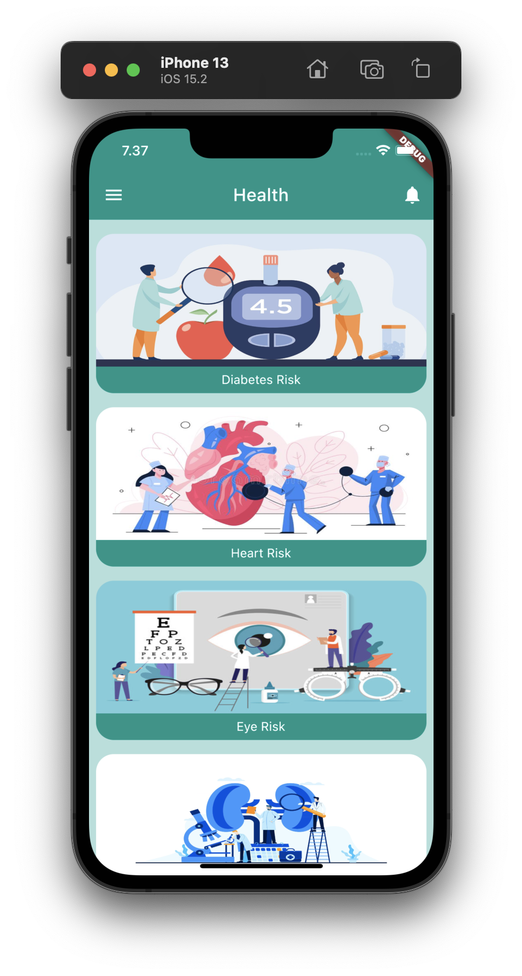
Project Evidence - IT19115894
Action Panel
Logbook Screen
Health Screen

Slide 17
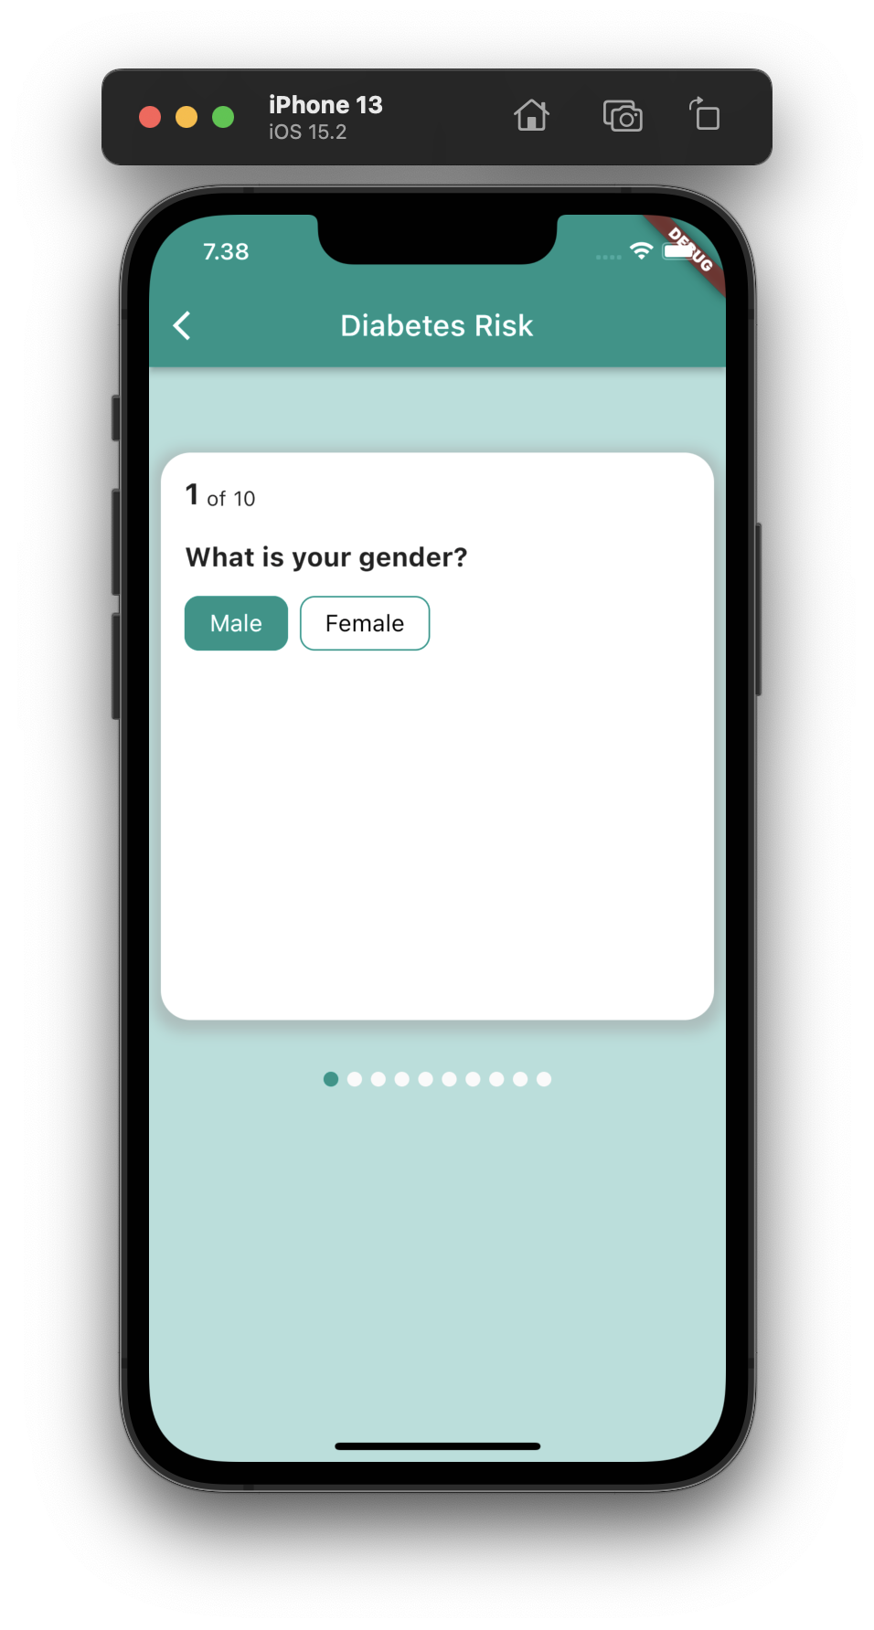
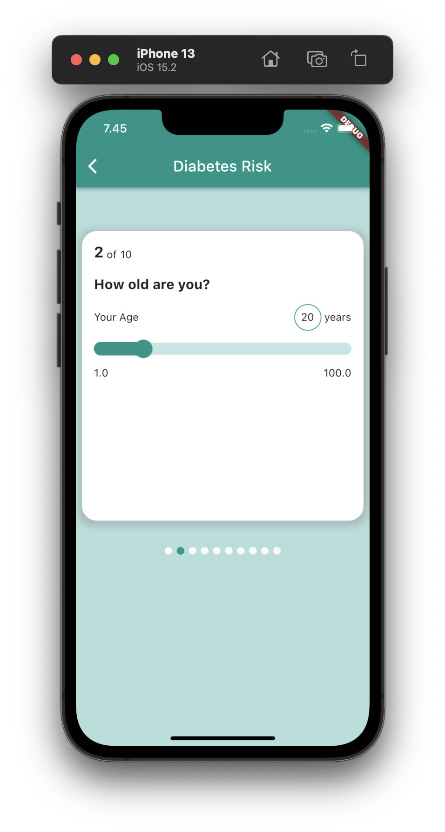
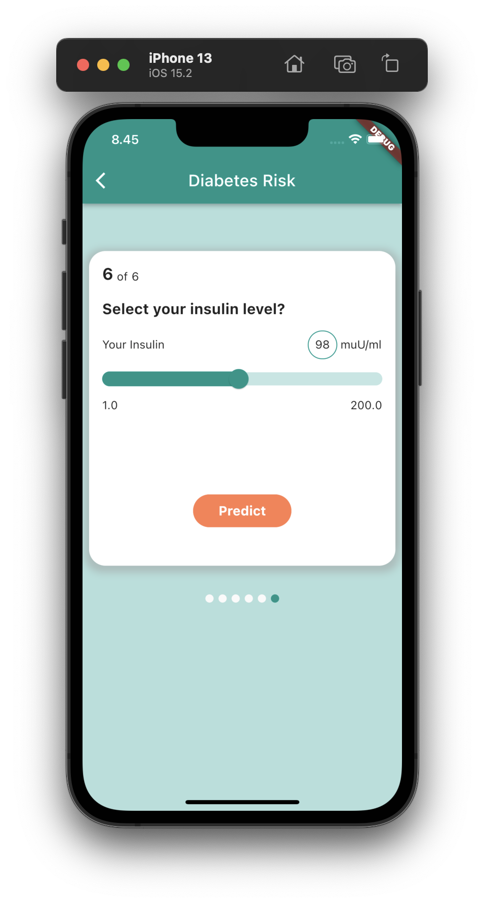
Project Evidence - IT19115894
Questionnaire

Slide 18
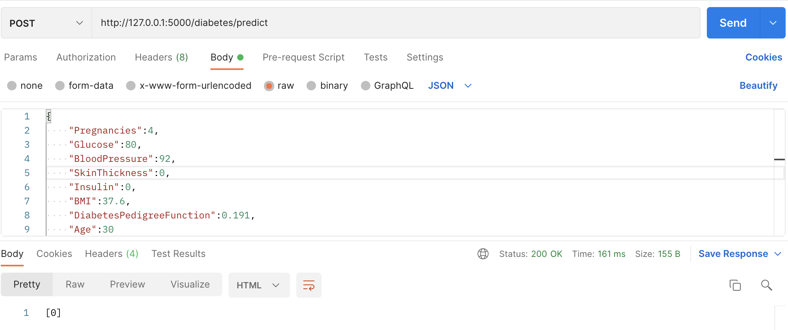
Project Evidence - IT19115894
Diabetes Predict API

Slide 19
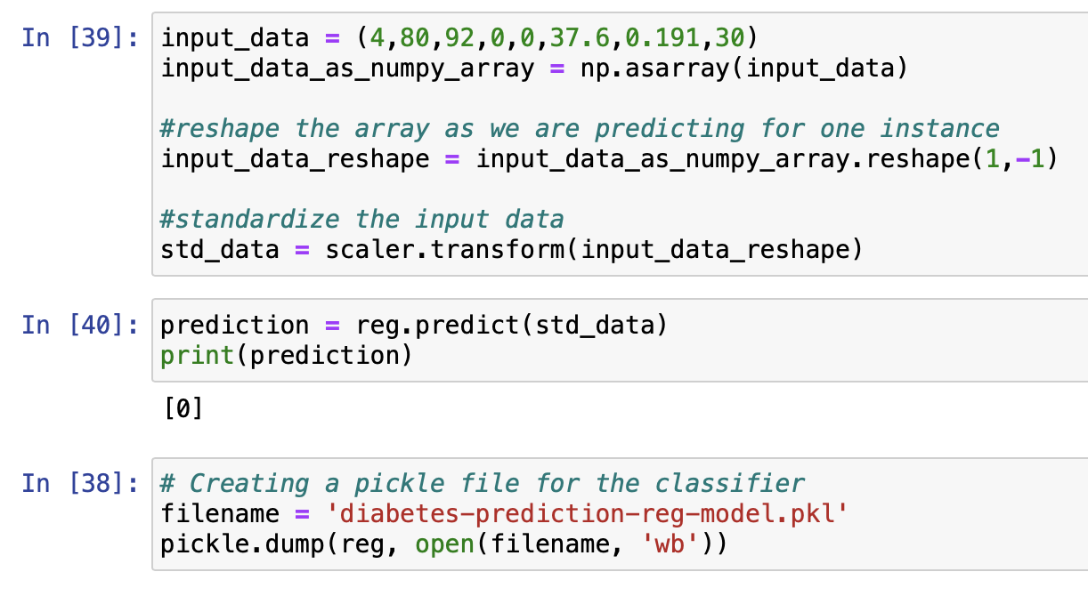
Project Evidence - IT19115894
Diabetes Prediction Model

Slide 20
Next Expected Progress– IT19115894
Send user reminders and recommendations
Provide data visualization graphs for DiaBeta App
Implement Web UI
Integrate Diabetes Predict API with DiaBeta App and Web UI
IT19115894 | Jayasekara J.T.N.N| Project ID : 2022-256

Slide 21
References
[1] “Basics,” CDC, 2019. https://www.cdc.gov/diabetes/basics/index.html.
‌[2] N. S. Khan, M. H. Muaz, A. Kabir, and M. N. Islam, “Diabetes Predicting mHealth Application Using Machine Learning,” IEEE Xplore, Dec. 01, 2017. https://ieeexplore.ieee.org/document/8468885 (accessed Jan. 24, 2022).
[3] A. S. Alanazi and M. A. Mezher, “Using Machine Learning Algorithms For Prediction Of Diabetes Mellitus,” IEEE Xplore, Sep. 01, 2020. https://ieeexplore.ieee.org/abstract/document/9213708 (accessed Jan. 24, 2022)
[4] “Pima Indians Diabetes Database,” www.kaggle.com. https://www.kaggle.com/datasets/uciml/pima-indians-diabetes-database
[5] K. VijiyaKumar, B. Lavanya, I. Nirmala, and S. S. Caroline, “Random Forest Algorithm for the Prediction of Diabetes,” IEEE Xplore, 2019. https://ieeexplore.ieee.org/document/8878802 (accessed May 02, 2021).
IT19115894 | Jayasekara J.T.N.N| Project ID : 2022-256

Slide 22
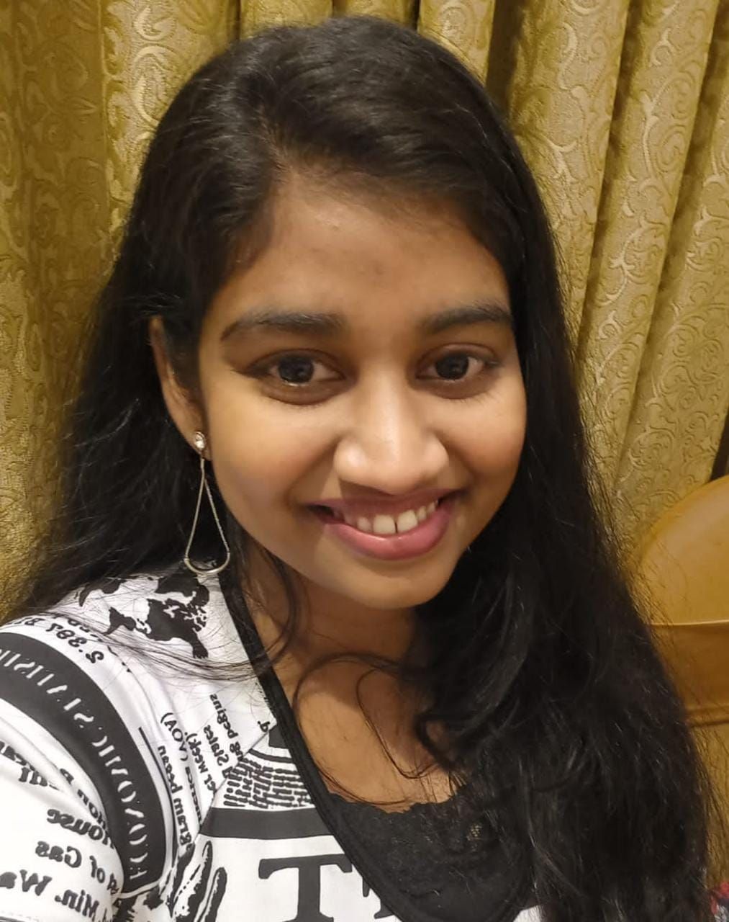
Recommend Diet and Exercise Plan
R.H. Gunasekera
IT19184272
Software Engineering

Slide 23
Research Questions
Can people reverse their type 2 diabetes condition with diet and exercise?
How to generate diet plan in accordance with required calorie?
How to generate exercises in accordance with blood glucose level and body composition assessment?

Slide 24
Specific and Sub Objectives
about time to take medicine, clinic dates and other important facts is also helpful.
Recommend diet plan.
Recommend exercise plan.
Calculating calorie count of the meal using an API.
Calculating estimated calories burned for the exercises using an API.

Slide 25
Methodology
01
03
System Diagram
Requirements
02
Technology
IT19184272 | Gunasekera R.H. | Project ID : 2022-256

Slide 26
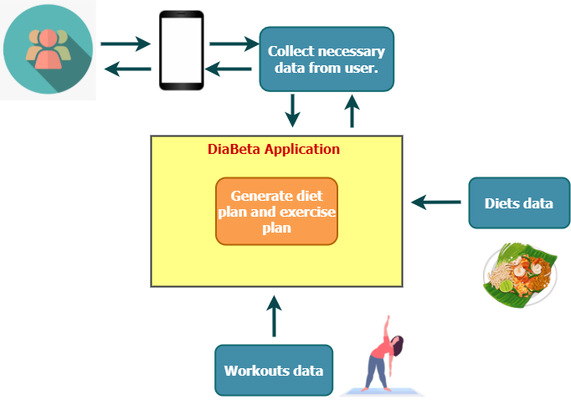
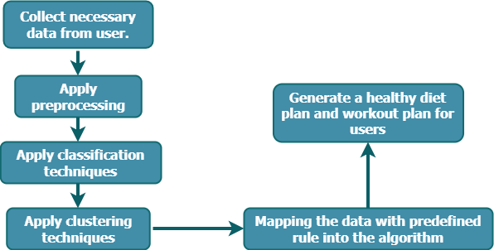
System Diagram
IT19184272 | Gunasekera R.H. | Project ID : 2022-256

Slide 27
Tools and Technologies
Tools
V
Visual Studio Code
Postman
Jupyter Notebook
Flask
Fire Base
Technologies
V
Flutter
Dart
Python
PHP
IT19115894 | Jayasekara J.T.N.N| Project ID : 2022-256

Slide 28
Current Progress – IT19184272 (90%)
Implement diet recommendation model.
Implement calorie count of the meal using CalorieNinja
API.
Implement estimated calorie burned for exercises using Nutritionix API.
Implement user interfaces.
90%
IT19184272 | Gunasekera R.H. | Project ID : 2022-256

Slide 29
Screenshots of the current work
Project Evidence
IT19184272 | Gunasekera R.H. | Project ID : 2022-256

Slide 30
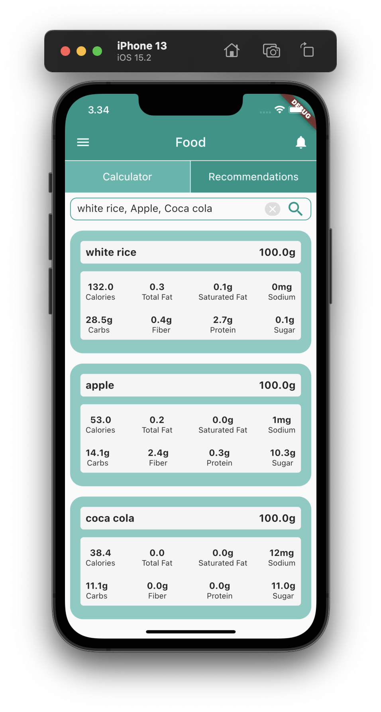
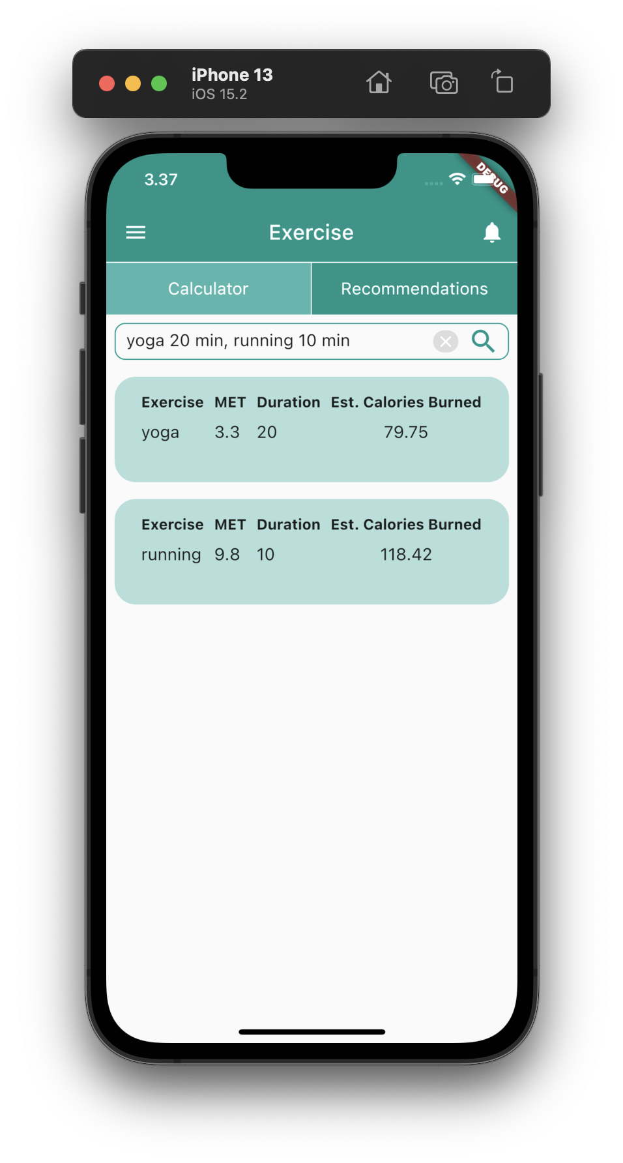
Project Evidence – IT19184272
Meal calorie calculator.
Estimated calorie burned calculator.
30

Slide 31
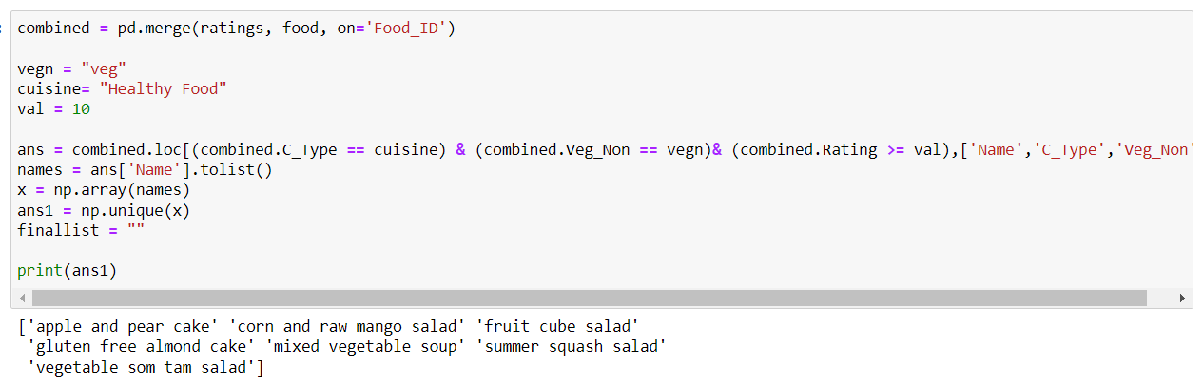
Project Evidence – IT19184272
Meal Recommendation model
IT19184272 | Gunasekera R.H. | Project ID : 2022-256

Slide 32
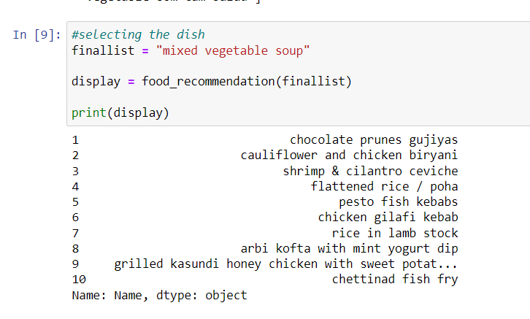
Project Evidence – IT19184272
IT19184272 | Gunasekera R.H. | Project ID : 2022-256
32

Slide 33
Next Expected Progress– IT19184272
Implement exercise recommendation model.
Deploy model using flask and create API.
Deploy each services using Docker and Kubernetes.
Integrate meal recommend API and exercise recommend API with DiaBeta App.
IT19184272 | Gunasekera R.H. | Project ID : 2022-256

Slide 34
References
[1] Athanasiou, Maria, et al. “An LSTM-Based Approach towards Automated Meal Detection from Continuous Glucose Monitoring in Type 1 Diabetes Mellitus.” 2021 IEEE 21st International Conference on Bioinformatics and Bioengineering (BIBE), 25 Oct. 2021, 10.1109/bibe52308.2021.9635246. Accessed 23 Jan. 2022.
[2] Basnayake, Chamali, et al. “Recommender System Based on Food and Exercise Ontologies to Find the Suitable Fitness Exercise Plan with the Aid of Python.” 2021 5th SLAAI International Conference on Artificial Intelligence (SLAAI-ICAI), 6 Dec. 2021, 10.1109/slaai-icai54477.2021.9664742. Accessed 23 Jan. 2022.
[3] Klimontov, V, et al. Serum Levels of WISP1/CCN4 in Subjects with Type 2 Diabetes: The Relationships with Body Fat Distribution and Adipose Tissue Dysfunction.
Li, Zhizhuang, et al. “Exercise Recommendation Method Based on Machine Learning.” 2021 International Conference on Advanced Learning Technologies (ICALT), July 2021, 10.1109/icalt52272.2021.00023. Accessed 24 Jan. 2022.
[4] O'brien, Richard, et al. Meal Size Estimation Using a Personalized Glucose-Insulin Model for Diabetic Patients.
Ofli, Ferda, et al. “Design and Evaluation of an Interactive Exercise Coaching System for Older Adults: Lessons Learned.” IEEE Journal of Biomedical and Health Informatics, vol. 20, no. 1, Jan. 2016, pp. 201–212, 10.1109/jbhi.2015.2391671. Accessed 24 Jan. 2022.
[5] Peihua, Liu. Research on the Effect of Exercise on Diabetics.
Popa, Grigore, and Ghenadie Usic. The 8 Th IEEE International Conference on E-Health and Bioengineering -EHB 2020 Development of a Patient-Specific Model for Patients with Diabetes Type I Using Meal and Exercise Guidelines from Modern Schools of Diabetes Me. 2020.
[6] Qiuhua, Wang, and Chen Peiyou. “Research on Individualized Exercise Energy Expenditure Models and Its Application in Walking-Running Exercise Prescription.” 2009 Second International Conference on Information and Computing Science, 2009, 10.1109/icic.2009.379. Accessed 8 Feb. 2022.
[8] ZITOUNI, Hanane, et al. “Personalized Menu: A New Contextual Collaborative Recommender System.” 2020 International Conference on Advanced Aspects of Software Engineering (ICAASE), 28 Nov. 2020, 10.1109/icaase51408.2020.9380111. Accessed 8 Feb. 2022.
IT19184272 | Gunasekera R.H. | Project ID : 2022-256

Slide 35
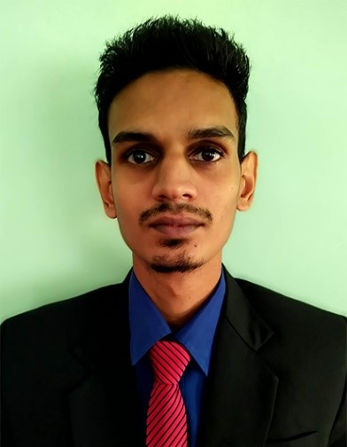
Identify Health Risk
Ravindu Hasanka V.G.
IT19156798
Information Technology

Slide 36
Research Questions
As people's standard of living rises, diabetes becomes more prevalent in their daily lives.
People with diabetes are often at risk for health risks.
Therefore, the potential health risk of diabetes is important, and it would be very useful if the user could use a mobile app to identify the potential health risk of their diabetes.

Slide 37
Specific and Sub Objectives
Generates a questionnaire to gather the required information from the user and to analyze the answers in the questionnaire.
Using a mobile app makes it easy to identify the health risks of diabetes
Handle the automating algorithm
Prevent risk of Health.

Slide 38
Methodology
01
03
System Diagram
Requirements
02
Technology
IT19156798 | Ravindu Hasanka V.G.| Project ID : 2022-256

Slide 39
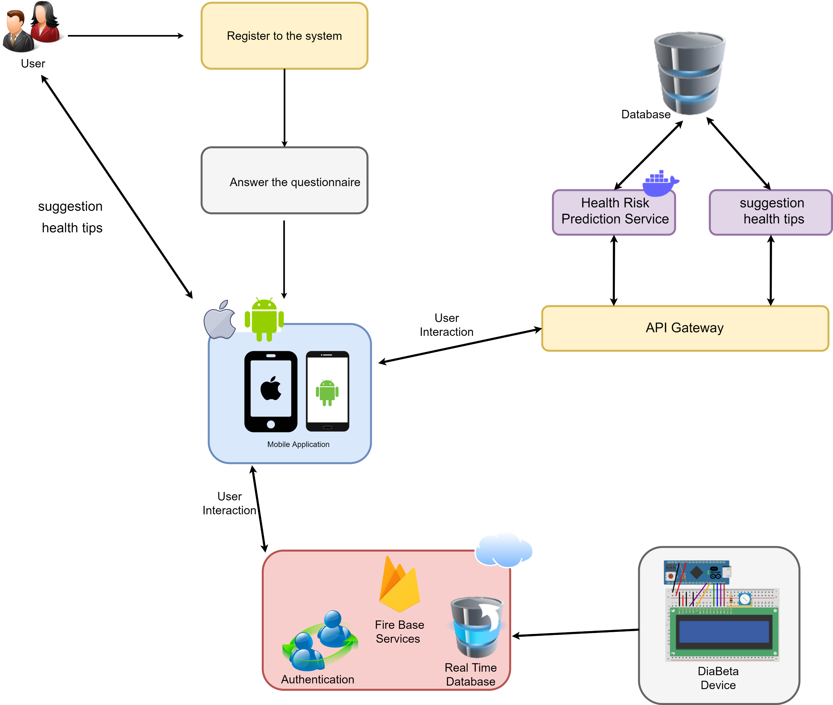
System Diagram
IT19156798 | Ravindu Hasanka V.G.| Project ID : 2022-256

Slide 40



Tools and Technologies
Tools
Visual Studio​
Jupiter Notebook
ReactJS​
Firebase
Technologies
​
Phyton​
Flutter​
Dart
IT19156798 | Ravindu Hasanka V.G.| Project ID : 2022-256

Slide 41
Current Progress – IT19156798 (90%)
Implement Heart Risk prediction model.
Implement Kidney Risk prediction model.
Implement Eye Risk prediction model.
Deploy model using flask and create API.
Created the Mobile Application Interface.
Generates a questionnaire to gather necessary information from the user.
Integrate Health Risk Predict API with DiaBeta App
90%
IT19156798 | Ravindu Hasanka V.G.| Project ID : 2022-256

Slide 42
Screenshots of the current work
Project Evidence
IT19156798 | Ravindu Hasanka V.G.| Project ID : 2022-256

Slide 43
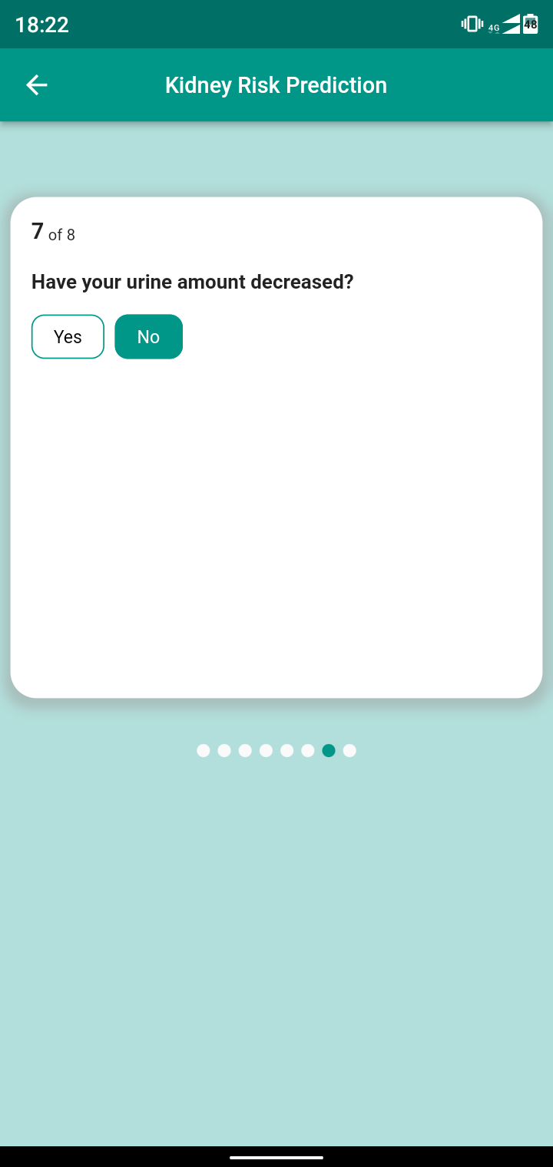
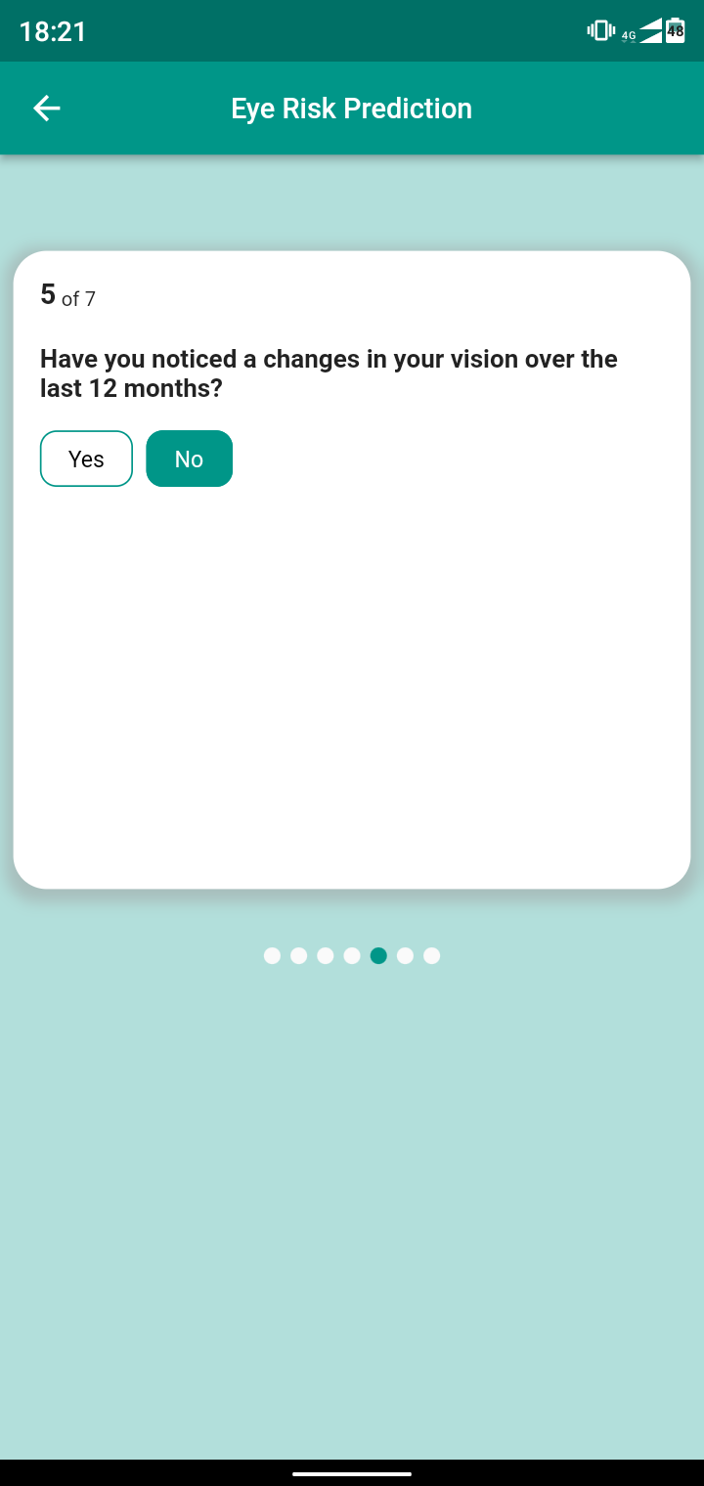

Project Evidence – IT19156798
IT19156798 | Ravindu Hasanka V.G.| Project ID : 2022-256

Slide 44
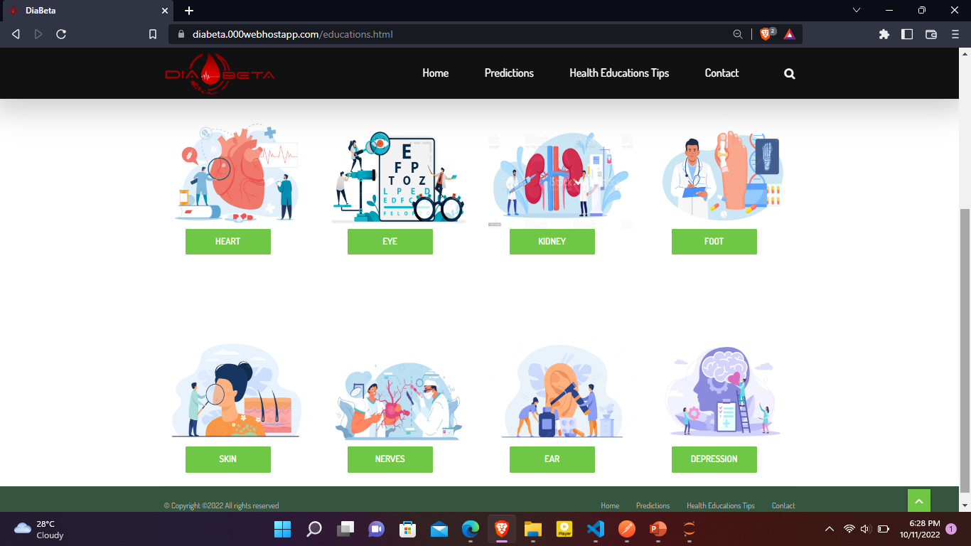
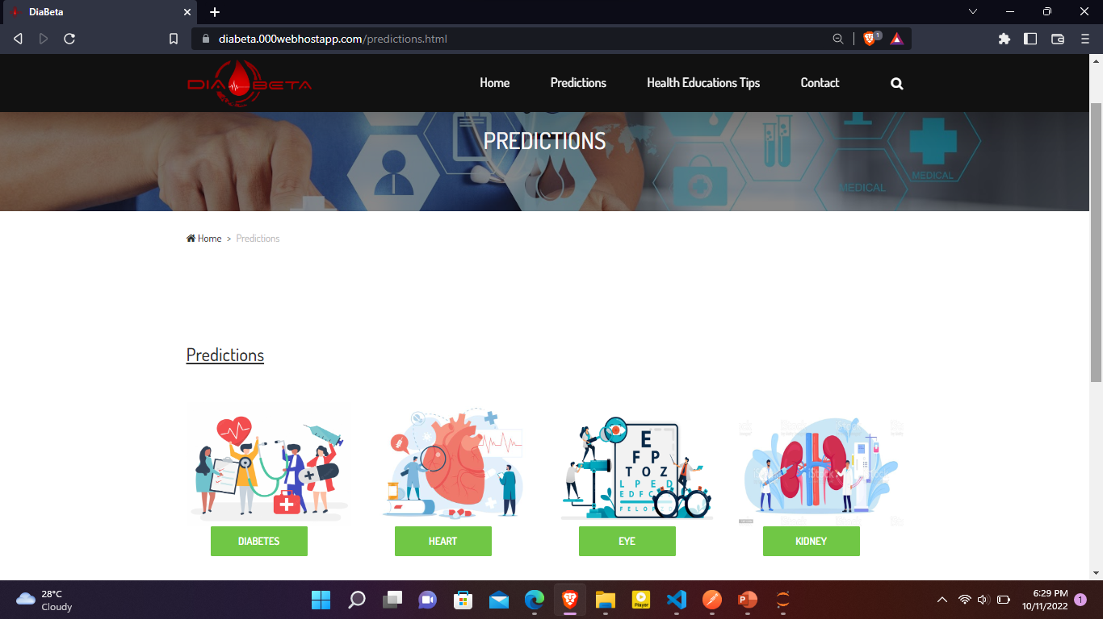
Project Evidence – IT19156798
IT19156798 | Ravindu Hasanka V.G.| Project ID : 2022-256

Slide 45
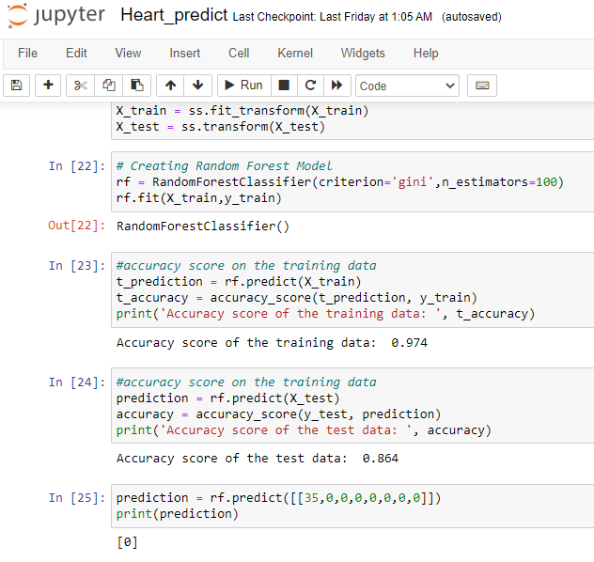
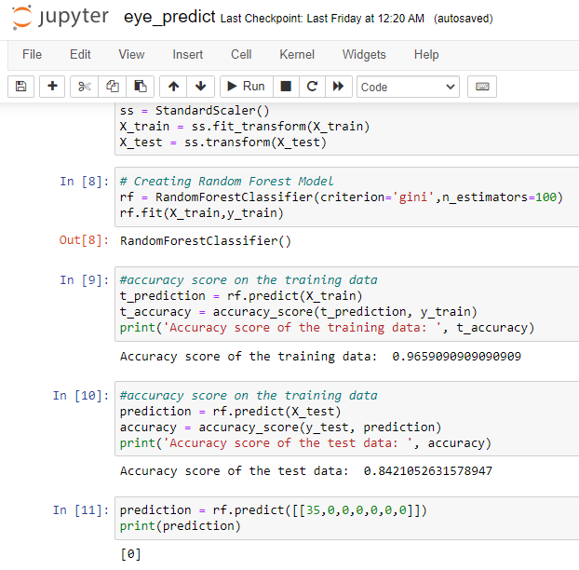
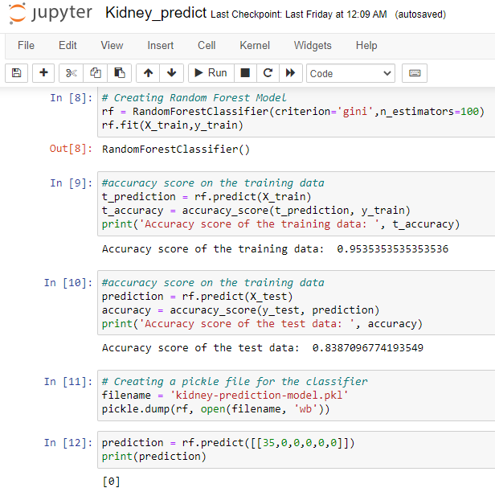
IT19156798 | Ravindu Hasanka V.G.| Project ID : 2022-256

Slide 46
Next Expected Progress – IT19156798
Integrate Health Risk Predict API with DiaBeta Website.
IT19156798 | Ravindu Hasanka V.G.| Project ID : 2022-256

Slide 47
References
[1]"Eye disease dataset", Kaggle.com, 2022. [Online]. Available : https://www.kaggle.com/datasets/kondwani/eye-disease-dataset.
[2]"Heart Disease Prediction", Kaggle.com, 2022. [Online]. Available: https://www.kaggle.com/code/andls555/heart-disease-prediction.
[3]"Chronic Kidney Disease Prediction ML", Kaggle.com, 2022. [Online]. Available: https://www.kaggle.com/code/chitturigopisaiteja/chronic-kidney-disease-prediction-ml.
[4]"GitHub - talhaanwarch/Eye_Disease_Classification_CNN: Eye Disease Classification using google images data", GitHub, 2022. [Online]. Available: https://github.com/talhaanwarch/Eye_Disease_Classification_CNN.
‌
IT19156798 | Ravindu Hasanka V.G.| Project ID : 2022-256

Slide 48
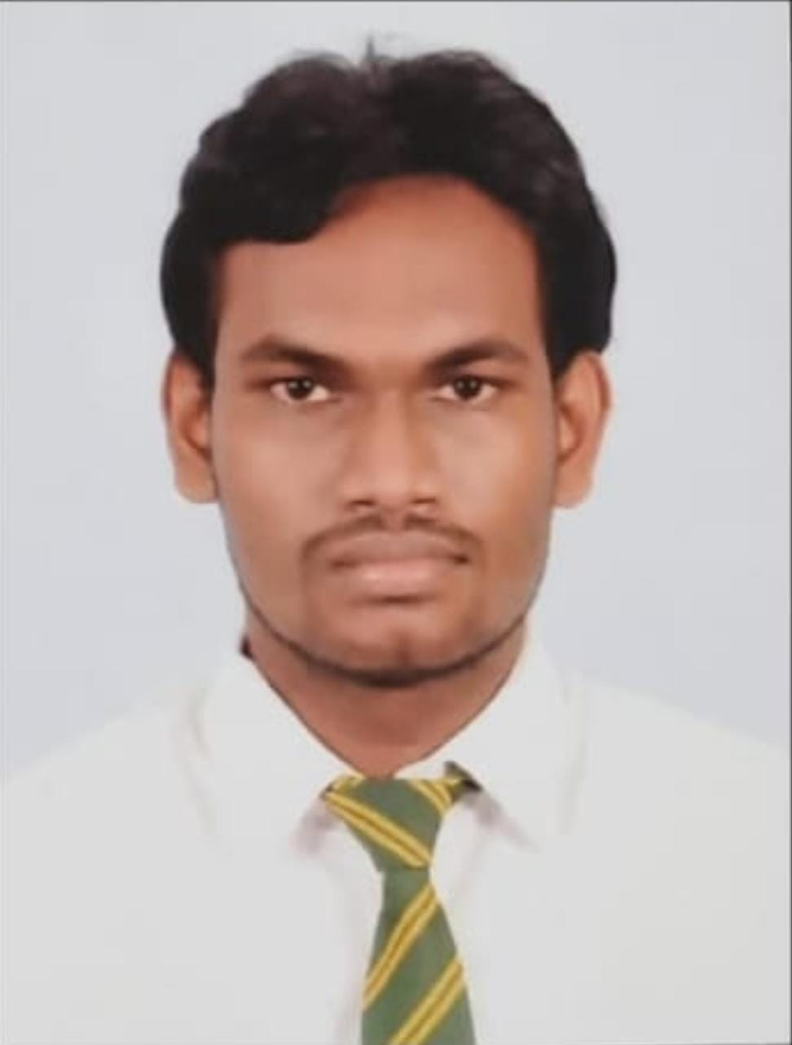
Non-invasive Glucose Level, Heart Rate and SpO2 Monitoring
Hasintha Kashmika H.B.G.
IT19115962
Computer System and Network Engineering

Slide 49
Research Questions
Measuring blood glucose by hand puncture is commonly seen as an invasive approach. Some people are reluctant to pierce their hands and measure their blood glucose levels.
Also, current heart rate components that measure blood oxygen levels(SPO2), and components that measure blood glucose are expensive.
The solution is to enable a monitoring system to measure blood glucose, heart rate, and blood oxygen level as a non-invasive approach using nodeMCU.
The device that measures blood glucose levels, heart rate, and blood oxygen level connects to the Firebase real-time database via Wi-fi

Slide 50
Specific and Sub Objectives
To establish a non-invasive blood glucose monitoring system
To establish a heart rate and blood oxygen level monitoring system
Connecting the device to the Firebase real-time database via WIFI
Implement the portable device to easily moved around

Slide 51
Methodology
01
03
System Diagram
Requirements
02
Technology
IT19115962 |Hasintha Kashmika H.B.G.| Project ID : 2022-256

Slide 52
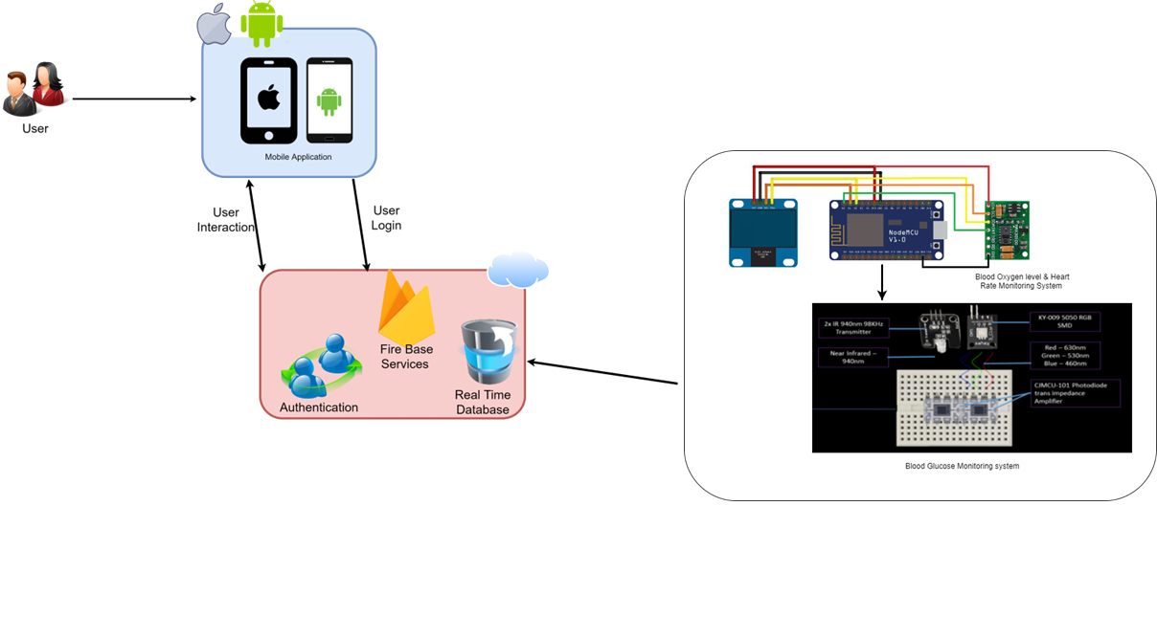
System Diagram
IT19115962 |Hasintha Kashmika H.B.G.| Project ID : 2022-256

Slide 53

Tools and Technologies
Tools​
Arduino IDE
Technologies​
Firebase​
Arduino C​
IT19115962 |Hasintha Kashmika H.B.G.| Project ID : 2022-256

Slide 54
Current Progress – IT19115962(90%)
Establishing a non-invasive blood glucose monitoring system for the DiaBeta mobile application.
Establishing a heart rate and blood oxygen monitoring system for the DiaBeta mobile application.
Connecting the device to the DiaBeta app via wi-fi
Executing and testing an Arduino code
Creating a low-cost, portable solution.
90%
IT19115962 |Hasintha Kashmika H.B.G.| Project ID : 2022-256

Slide 55
Project Evidence
IT19115962 |Hasintha Kashmika H.B.G.| Project ID : 2022-256

Slide 56
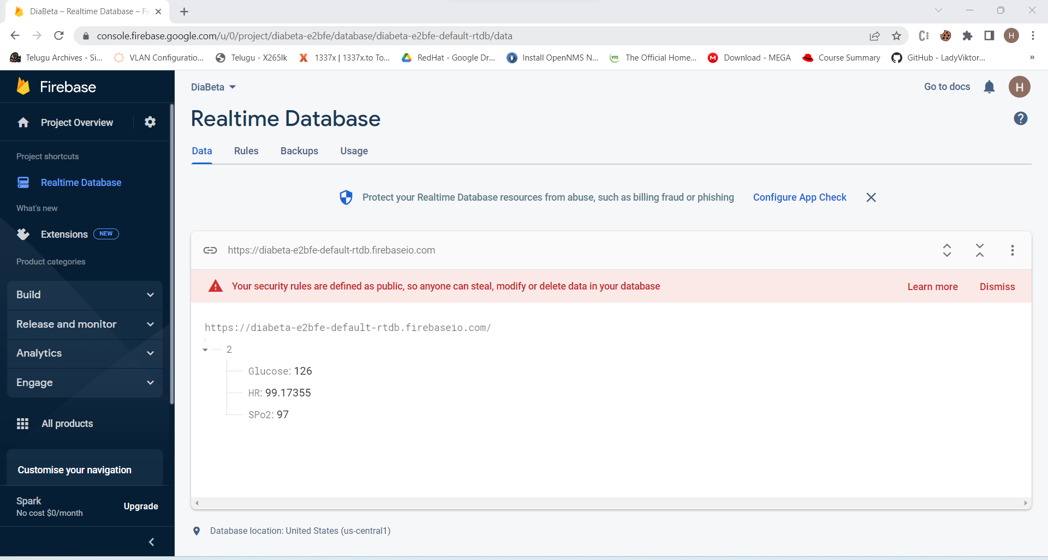
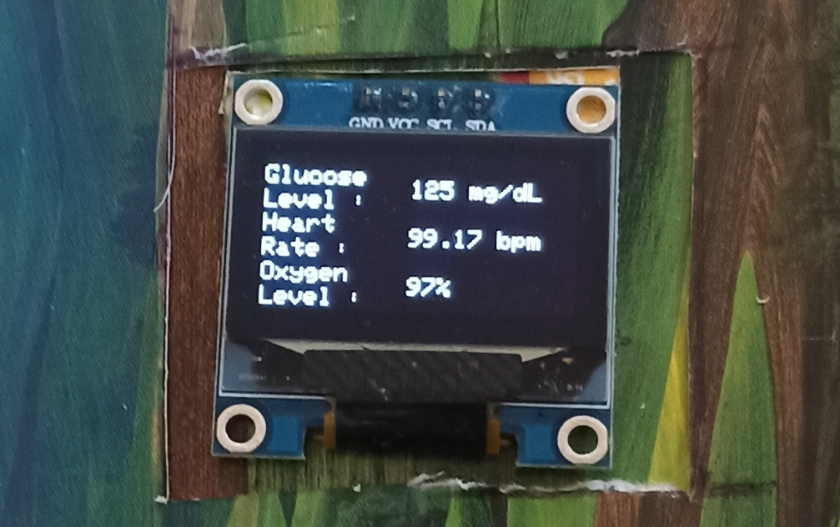
Project Evidence – IT19115962
IT19115962 |Hasintha Kashmika H.B.G.| Project ID : 2022-256

Slide 57
Next Expected Progress– IT19115962
IT19115962 |Hasintha Kashmika H.B.G.| Project ID : 2022-256

Slide 58
References
[1]“MAX30100 Pulse Oximeter with ESP8266 on Blynk IoT App,” How To Electronics, Jan. 12, 2020. https://how2electronics.com/max30100-pulse-oximeter-with-esp8266/
[2]“ESP8266: Getting Started with Firebase (Realtime Database) | Random Nerd Tutorials,” Sep. 18, 2021. https://randomnerdtutorials.com/esp8266-nodemcu-firebase-realtime-database/
[3]“Measure Heart Rate and SpO2 with MAX30102,” Arduino Project Hub. https://create.arduino.cc/projecthub/SurtrTech/measure-heart-rate-and-spo2-with-max30102-c2b4d8
[4] A. B. Reddy, A. K. Sai, and A. Sivasangari, “Non-Invasive Blood Glucose Level Monitoring Using IoT,” IEEE Xplore, Jun. 01, 2020. https://ieeexplore.ieee.org/document/9142887
‌[5]S. S. W. I. Udara, A. K. De Alwis, K. M. W. K. Silva, U. V. D. M. A. Ananda, and K. A. D. C. P. Kahandawaarachchi, “DiabiTech- Non-Invasive Blood Glucose Monitoring System,” IEEE Xplore, Dec. 01, 2019. https://ieeexplore.ieee.org/document/9103375 .
‌
‌
IT19115962 |Hasintha Kashmika H.B.G.| Project ID : 2022-256

Slide 59
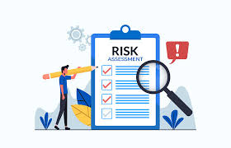
Risk Mitigation
Code in the GitLab
Having Cloud Storage for important documents
Working on plan with proper time management
IT19115962 |Hasintha Kashmika H.B.G.| Project ID : 2022-256

Slide 60

Best Practices
Code Management in GitLab
Study different datasets to choose most appropriate ones.
Having discussions with team and the supervisors.
Proper Structured Coding for different tasks in the research.
IT19115962 |Hasintha Kashmika H.B.G.| Project ID : 2022-256

Slide 61
Commercialization
01
03
Branding
Business Plan
02
Market Analysis

Slide 62
Branding
Create social media marketing plan.
Reserved custom social media domains.
Recognizing target audience

Slide 63
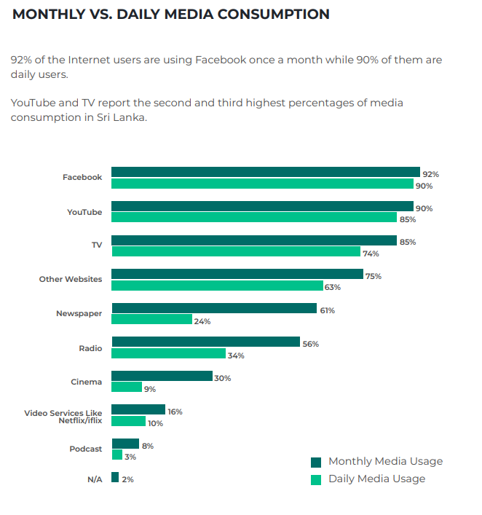
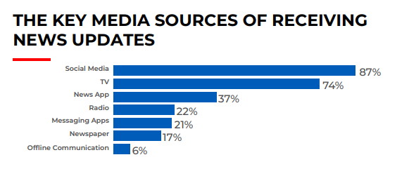
Market Analysis
Sources : Digital outlook SriLanka 2021

Slide 64
Thank you

Slide 65
